Slide 1
Project: Crime Analyzer
Course: Foundation of Data Science
Program: MSc (Data Science)
Academic Year: 2015/16
Team 5: 1. Miguel Ballesteros (mabm1e15)
2. Alun Meredith (am5e15)
3. Taoufik El Khiraoui (tek1g15)
4. Manu Llamas (mlf1g15)
5. Ali Shah (smas1c15)

Slide 2
Agenda
Scenario
Ideas
Project Scope
Application Demo
Technical Implementation
Data Collection
Data Cleansing/Pre-processing
Data modelling
Data Visualization
Conclusion

Slide 3
The idea
Populate crime data on UK map and predict risk zones
Sentiment Analysis of Tweets related to UK News
Populate crime data on London map and compare with other same size cities.
Populate crime data on London map and perform exploratory analysis
Notes:
During the brainstorming session, there were many ideas generated, but after careful evaluation and keeping the time and skillset in mind we shortlisted these four ideas.
Populate the crimes on UK map and find patterns to predict the potential crime risk in that area.
To perform sentiment analysis using Twitter and News data.
The team decided to merge the two ideas and reduce the scope from whole UK to London and to perform sentiment analysis of tweets related to crime only.
However, due to limitation in data granularity, inconsistency and not enough valid tweets available for specific crime, the team decided to redefine the scope and selected the option 4 i.e., “to populate crime data on London map and perform exploratory analysis”.

Slide 4
The project scope
Populate crime data on London map
and
perform exploratory analysis
Notes:
Idea Justification
The team is highly motivated that this project is challenging and will give us an opportunity to utilize the programming, data modelling and analytical skills.
The team is highly convinced that this application will help a common person to know the crime rate.
In future the unique feature will be that this application will give an opportunity to understand the relationship of crime with respect to weather, population, literacy rate, income level, unemployment level, poverty rate, deputed police force and so on.
Depends on the availability of datasets, we MAY incorporate cybercrime in this application.
I would like to request my colleague Miguel and Taoufik to give demo of this application.

Slide 5
Technical implementation

Slide 6
Data Collection

Slide 7
Data Cleansing/Pre-Processing

Slide 8
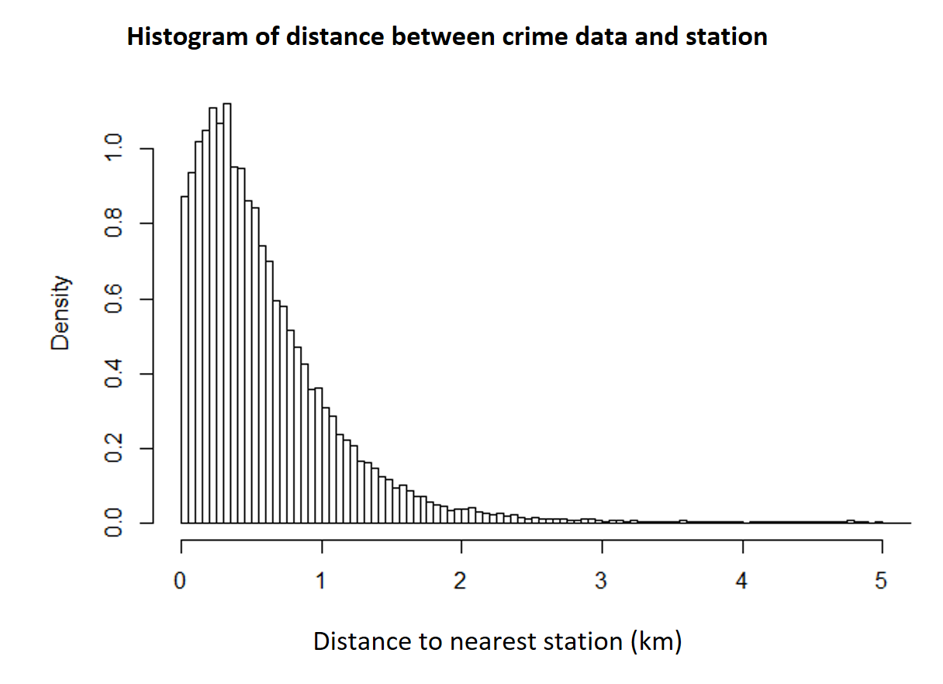
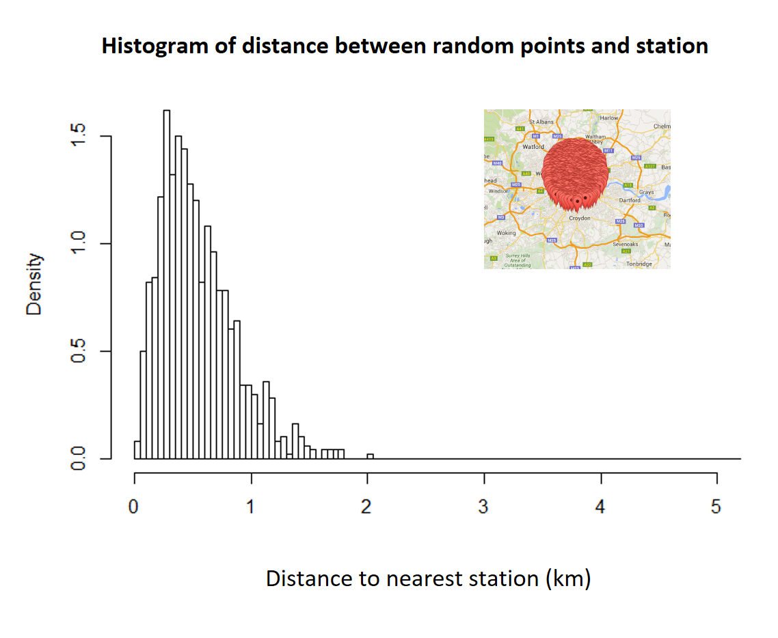
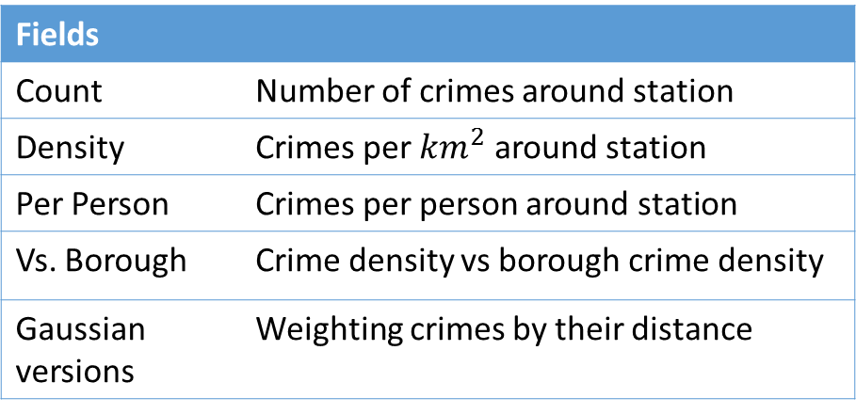
Data Modelling
Goal: Analyse the effect of points of interest on crime rates. Visualising the effect of those points on crime.
Process:
Count crimes per station
Calculate distance to nearest station.
Find number of crimes per station in circle.
Calculate area of circle removing overlap
Find number of stations and distances to those stations within circle diameter.
Apply Gaussian weighting.
Divide by Area / Borough Density / People.
Repeat process for different crime types and points of interest.
Fields
Count | Number of crimes around station
Density | Crimes per $km^{2}$around station
Per Person | Crimes per person around station
Vs. Borough | Crime density vs borough crime density
Gaussian versions | Weighting crimes by their distance
Notes:
Goal: So what fields are important to show that.
Fields: Why we picked each one
- Accounting for the big effects to see the small. .
- Gaussian Density vs Density: Model vs interpretability (esp. vs borough)
Process: Calculations done and why
- Crime count: Circle vs associated.
- Overlapping circles / Gaussian weights.
- Circle size / gaussian
Results:
- Show a couple of graphs of analysis, quick fire

Slide 9
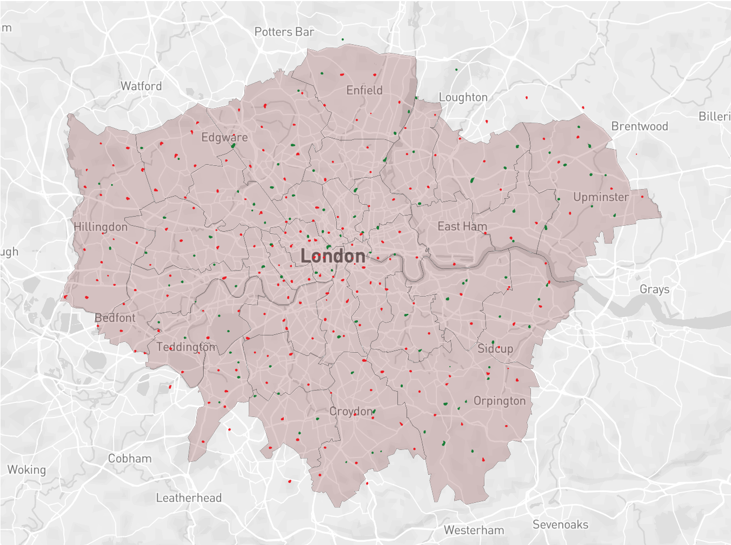
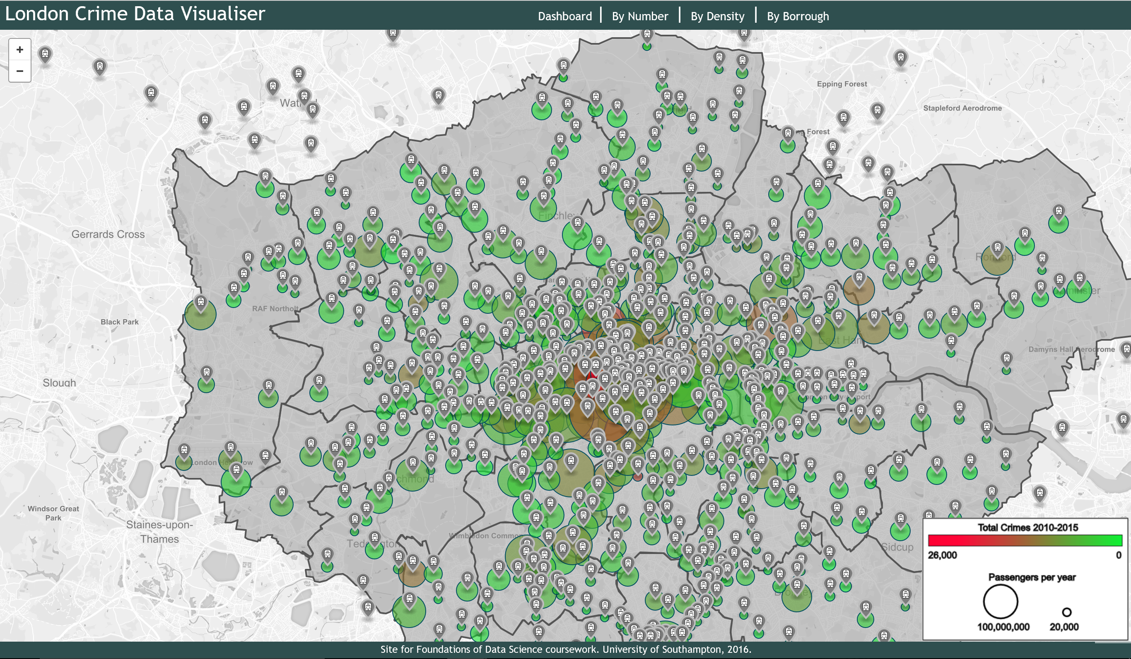
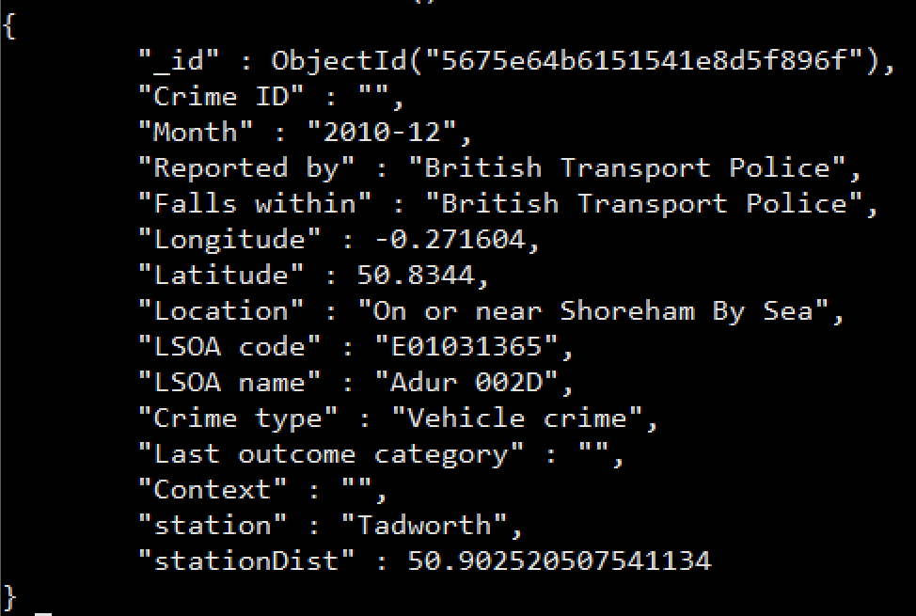
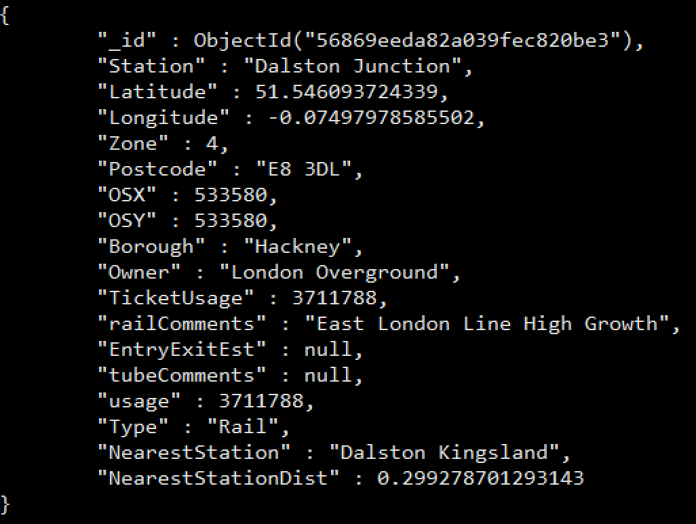
Data Visualisation
Crimes dataset schema
Stations dataset schema

Slide 10
Conclusion
Potential
Other people have visualised crime rates but rarely go beyond just reporting the numbers.
We have just scraped the surface.
What we learnt
The entire pipeline.
Different challenges of big data
Having good communication documentation and teamwork
Notes:
Potential
- Not just reporting numbers: Important insight, refer to use cases. Exploratory!
- We have just scraped the surface: Implementing the other data, very easy to translate to new datasets,
What we learnt
- The entire pipeline: How links together, forward planning of different stages and flexibility required.
- Big data: Simple calculations require a lot of thought and optimisation when repeated 10^7 times.
- Teamwork: If I have seen further than anyone else it is by standing on the shoulders of giants.

